Slide 1
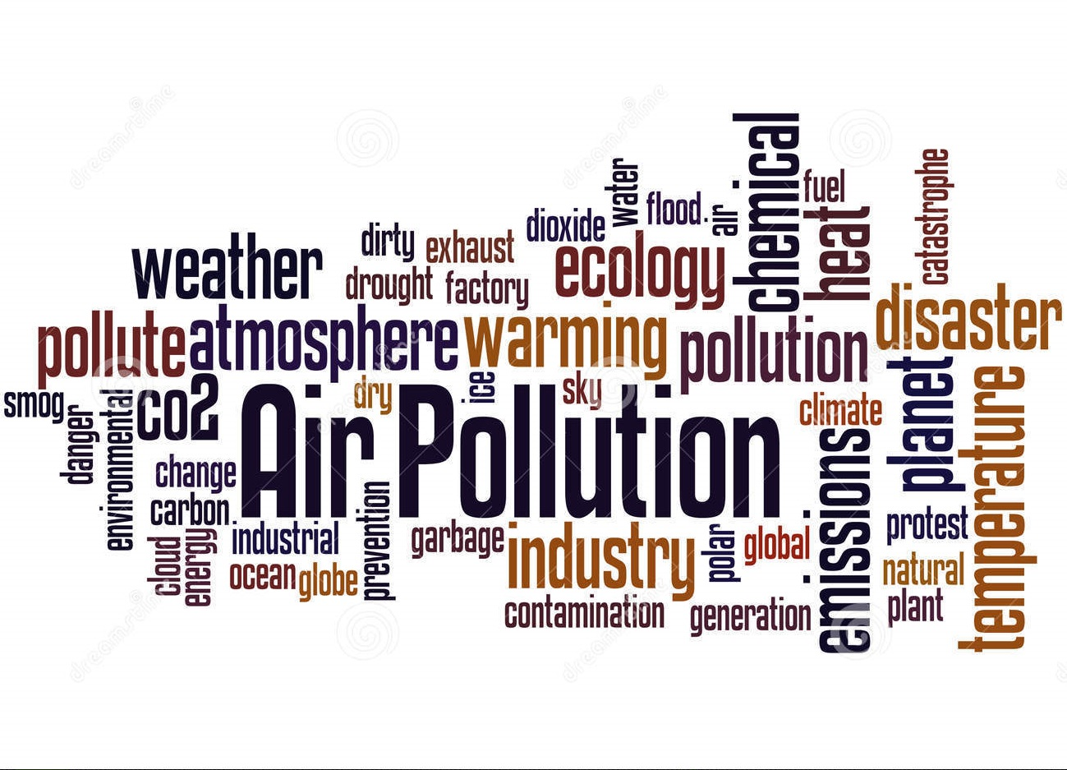
Team – DC20011
Topic – New Pollution

Slide 2
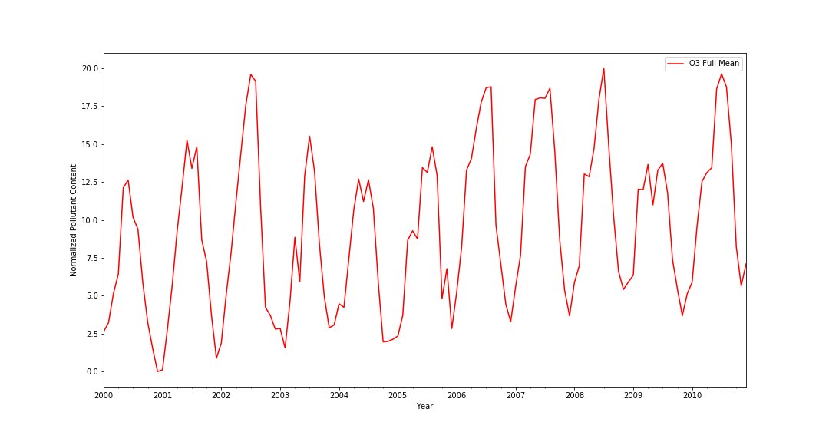
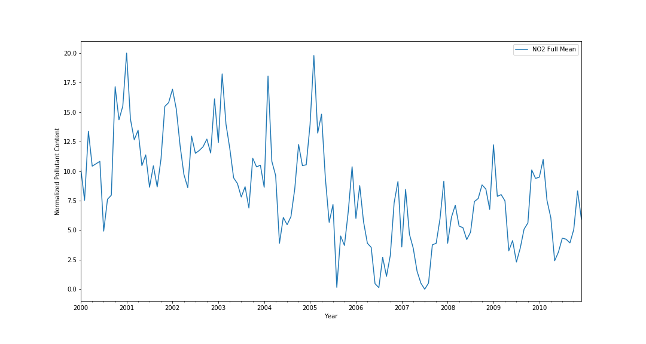
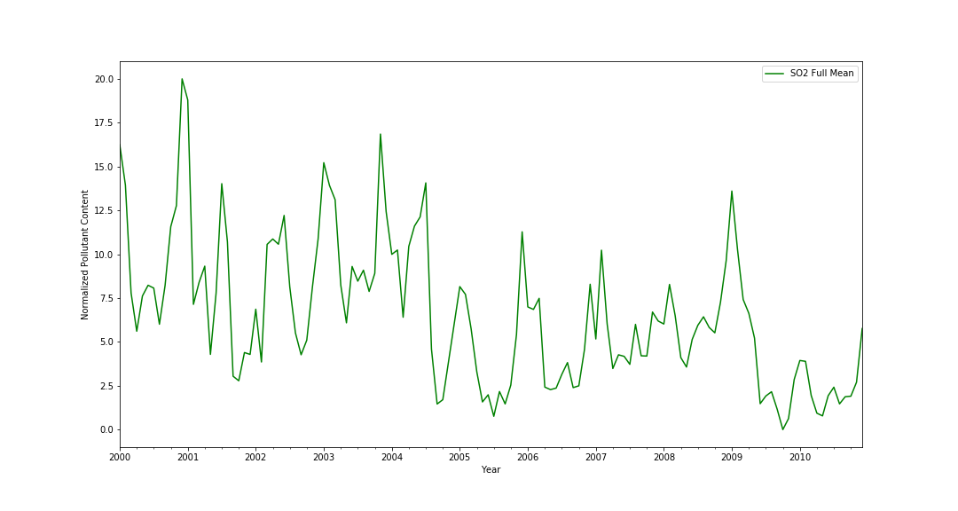
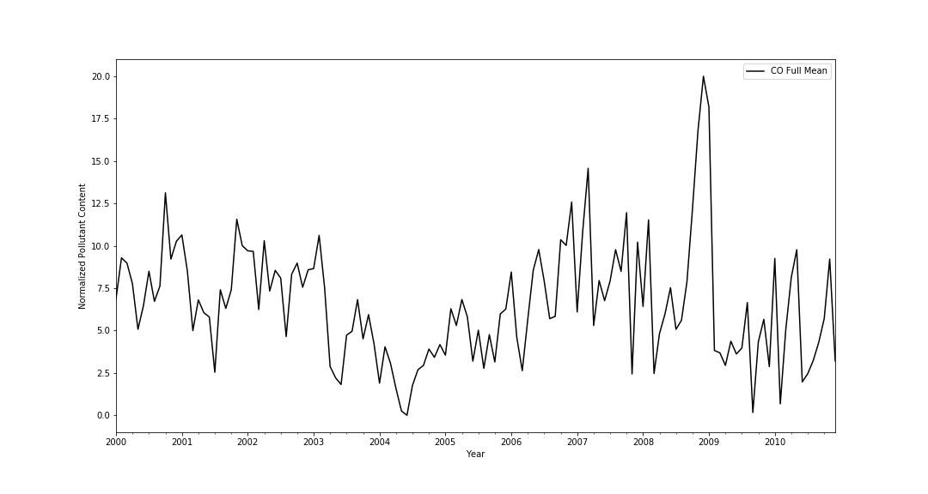
Month-Wise Pollutant Content For Year 2000-2010

Slide 3
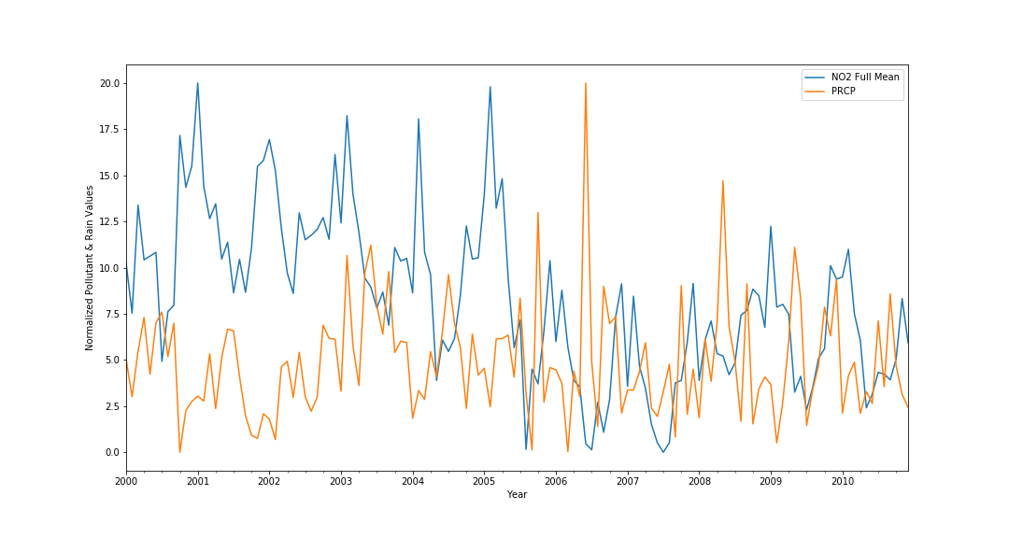
Rain Vs Pollutant

Slide 4
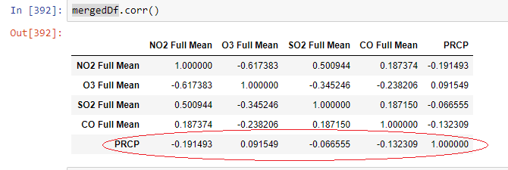
Correlation Between Pollutants and Precipitation

Slide 5
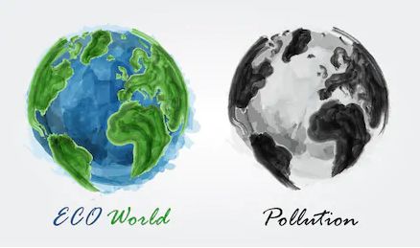
Global Effects

Slide 6
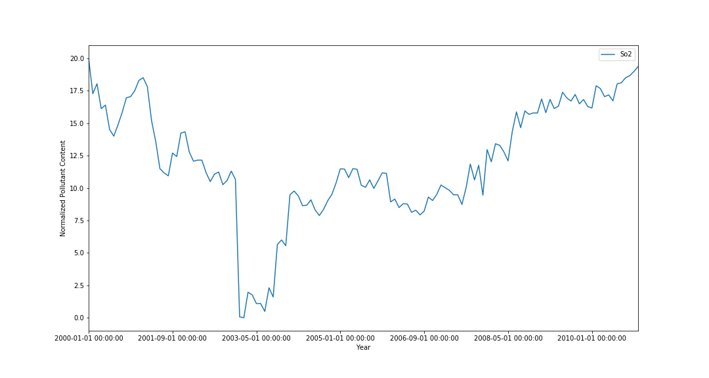
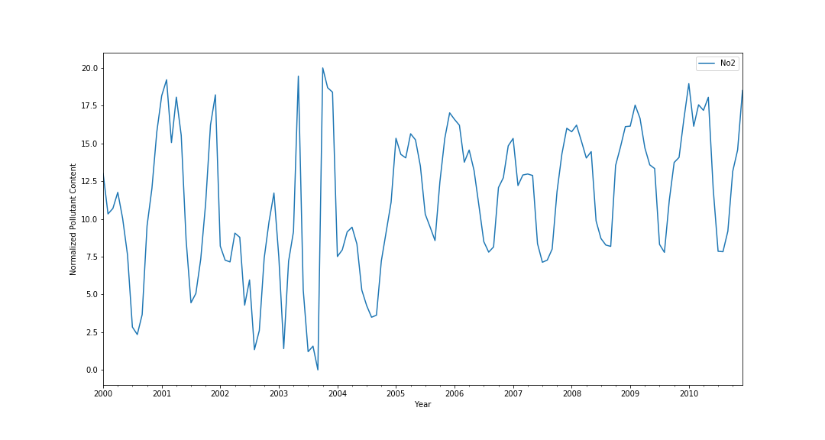
Pollutants in India

Slide 7
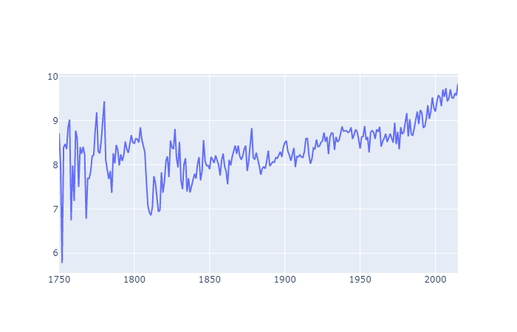
Increase in GLOBAL WARMING
Temperature in Degree Celsius
Year

Slide 8
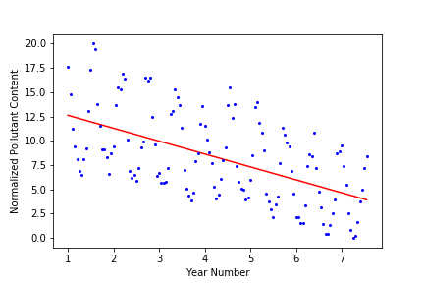
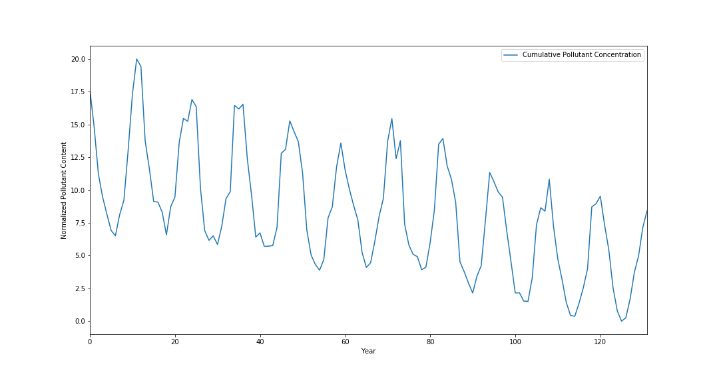
US Pollution

Slide 9
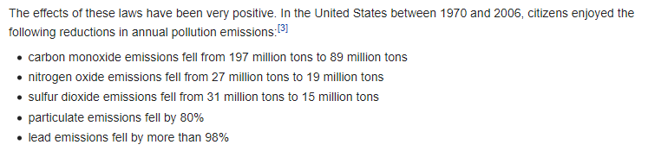
Reason For US Pollution Downward Trend
Source - Wikipedia

Slide 10
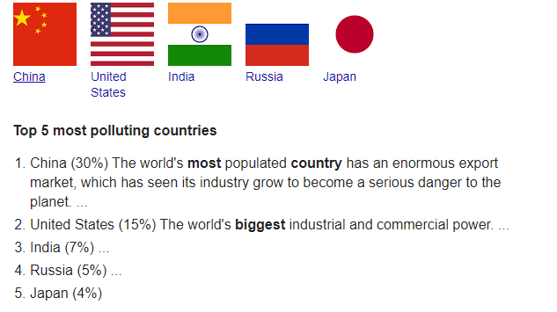

Slide 11
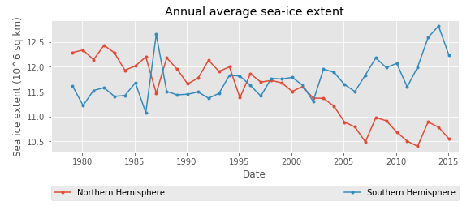
Polar Ice Extent

Slide 12
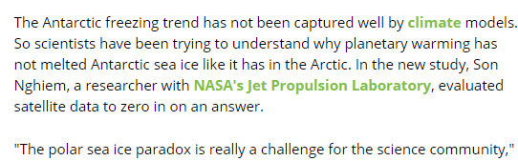
Paradox
Source-https://insideclimatenews.org/

Slide 13
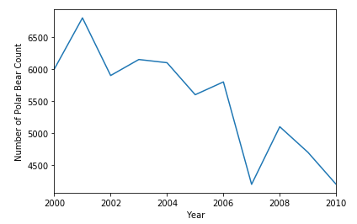
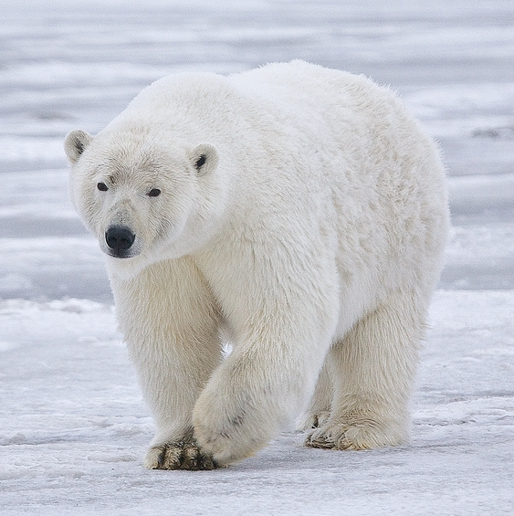
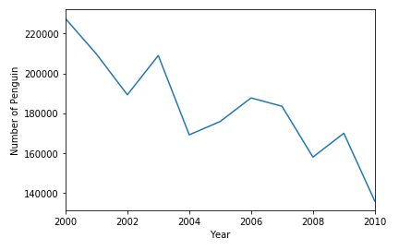
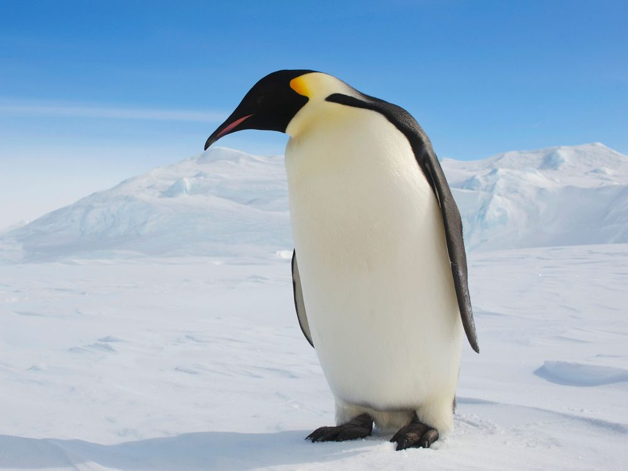
Endangered Species Population

Slide 14
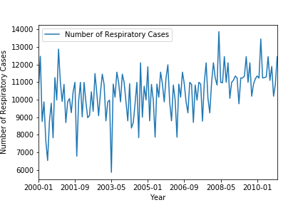
Effect On Humans

Slide 15

Future Scope

Slide 16
THANK YOU!!

Slide 17
Additional Slides

Slide 18
Findings
Slide 2-3-4
I plotted the month wise pollutants content for year 2000-2010. if I draw a mean line, it would be straight line or some what decreasing. But if we observe closely, we can see a pattern it goes down in the middle and then again rises. So, what is the reason. I researched and found that precipitation or rain could be a factor that could influence pollutant’s content. I gathered data and plotted it with cumulative pollutants data. So, you can see, whenever there is rain, the pollutants content is going down and vice versa.
Slide-6
Pollution of India is going up
Slide-7
Global pollution is going up
Slide-8
US pollution level is going down
Slide-11
Northern Hemisphere sea ice extent is going down while Southern Hemisphere ice extent is going up
Slide-13
Species like Penguin and Polar Bear are becoming endangered due to increasing planetary temperature
Slide-14
Respiratory cases are growing due to low air quality.

Slide 19
Data Links
Climate change
https://www.kaggle.com/berkeleyearth/climate-change-earth-surface-temperature-data
https://www.kaggle.com/nayansolanki2411/global-warming-eda/data
US Pollution
https://www.kaggle.com/sogun3/uspollution
India Pollution
https://www.kaggle.com/shrutibhargava94/india-air-quality-data
Ice Caps
https://www.kaggle.com/nsidcorg/daily-sea-ice-extent-data
Ozone
https://ourworldindata.org/ozone-layer

